Slide 1

League of Legends Roles analysis
Relato Alessandro
Advanced Data Science – 2024/2025

Slide 2
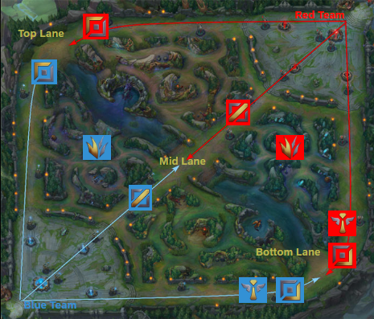
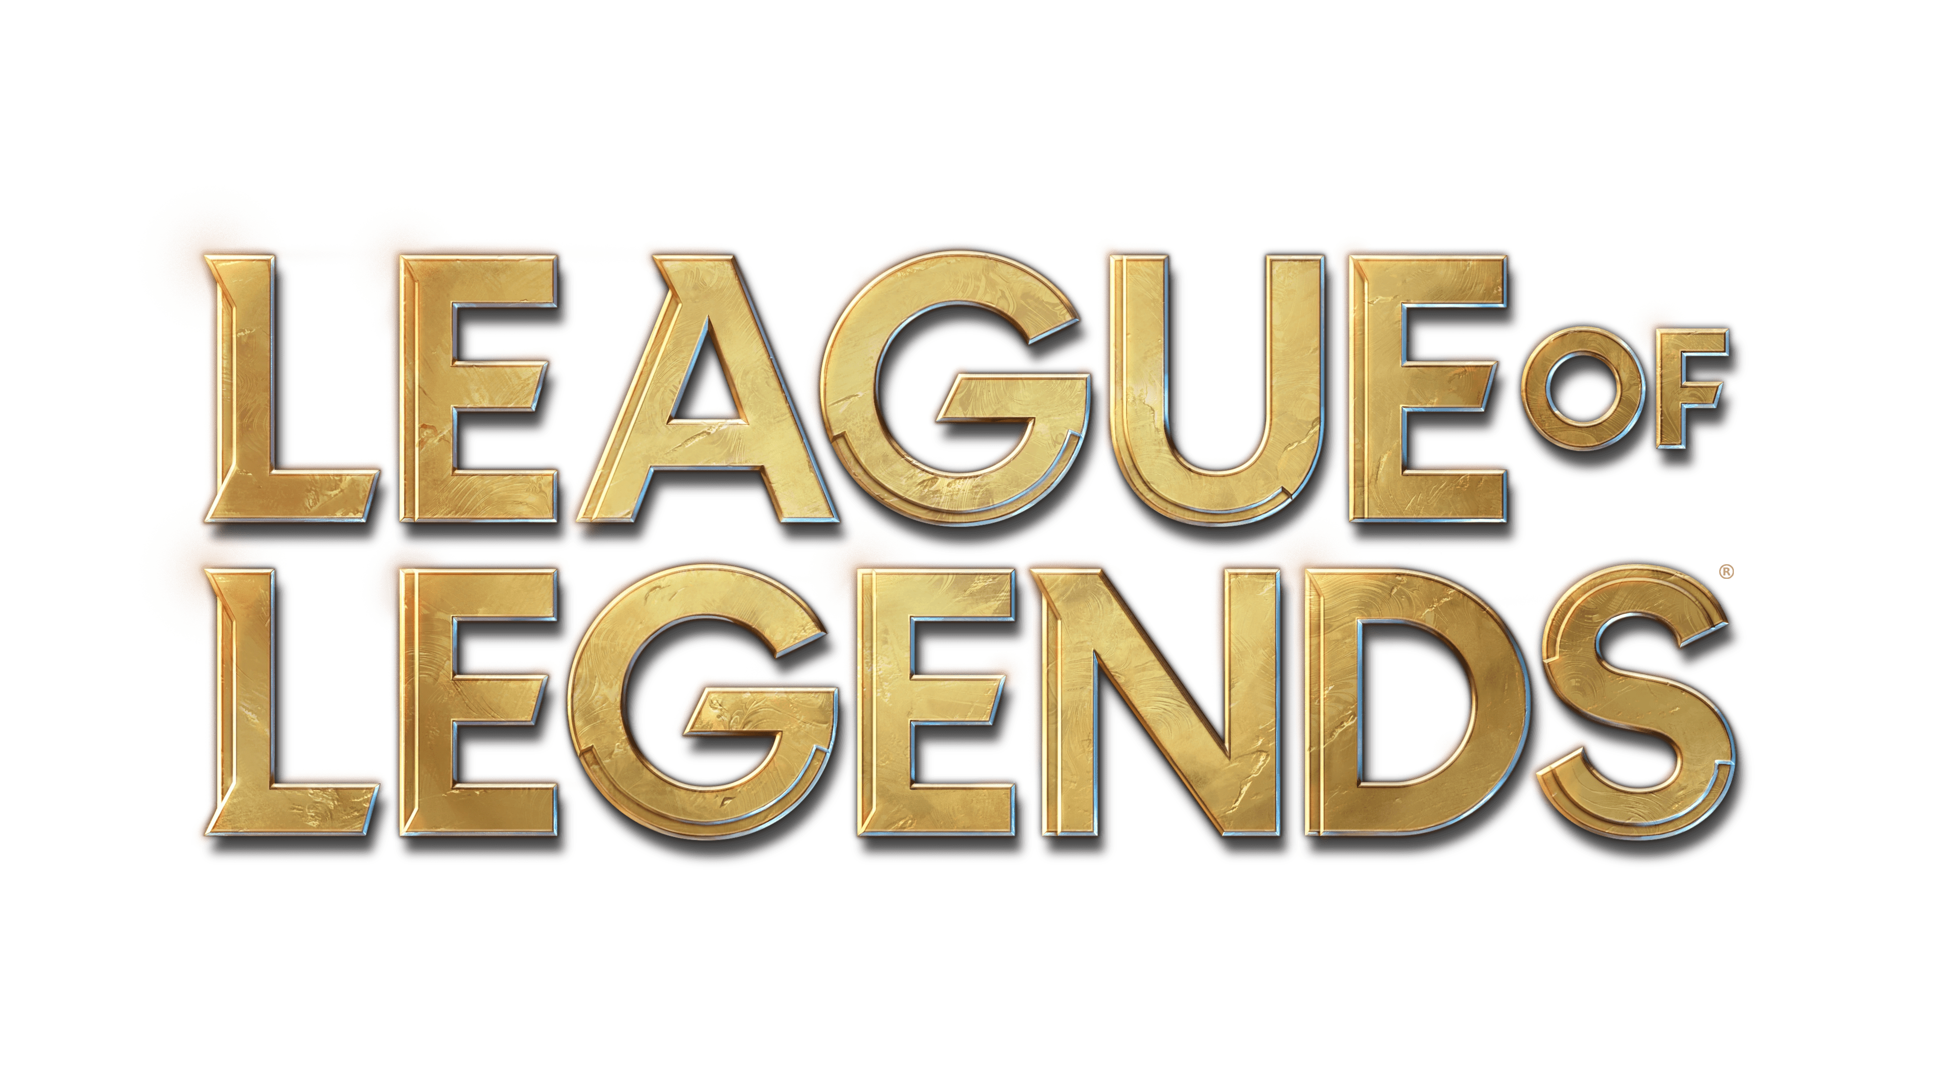
League of legends is a videogame created by Riot Games in which 2 teams of 5 players combat against each other aiming to destroy the enemy base.
Every player has a Role based on which part of the map he’s going to play on. There are 5 Roles: Toplaner, Jungler, Midlaner, ADCarry, Support.
I aim to analyze which Role has the most interactions with others.

Slide 3


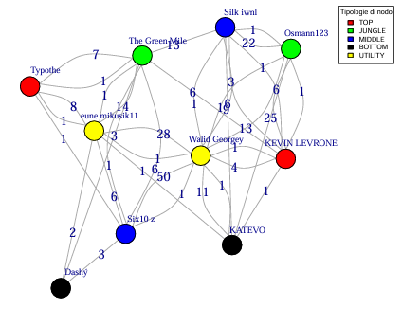
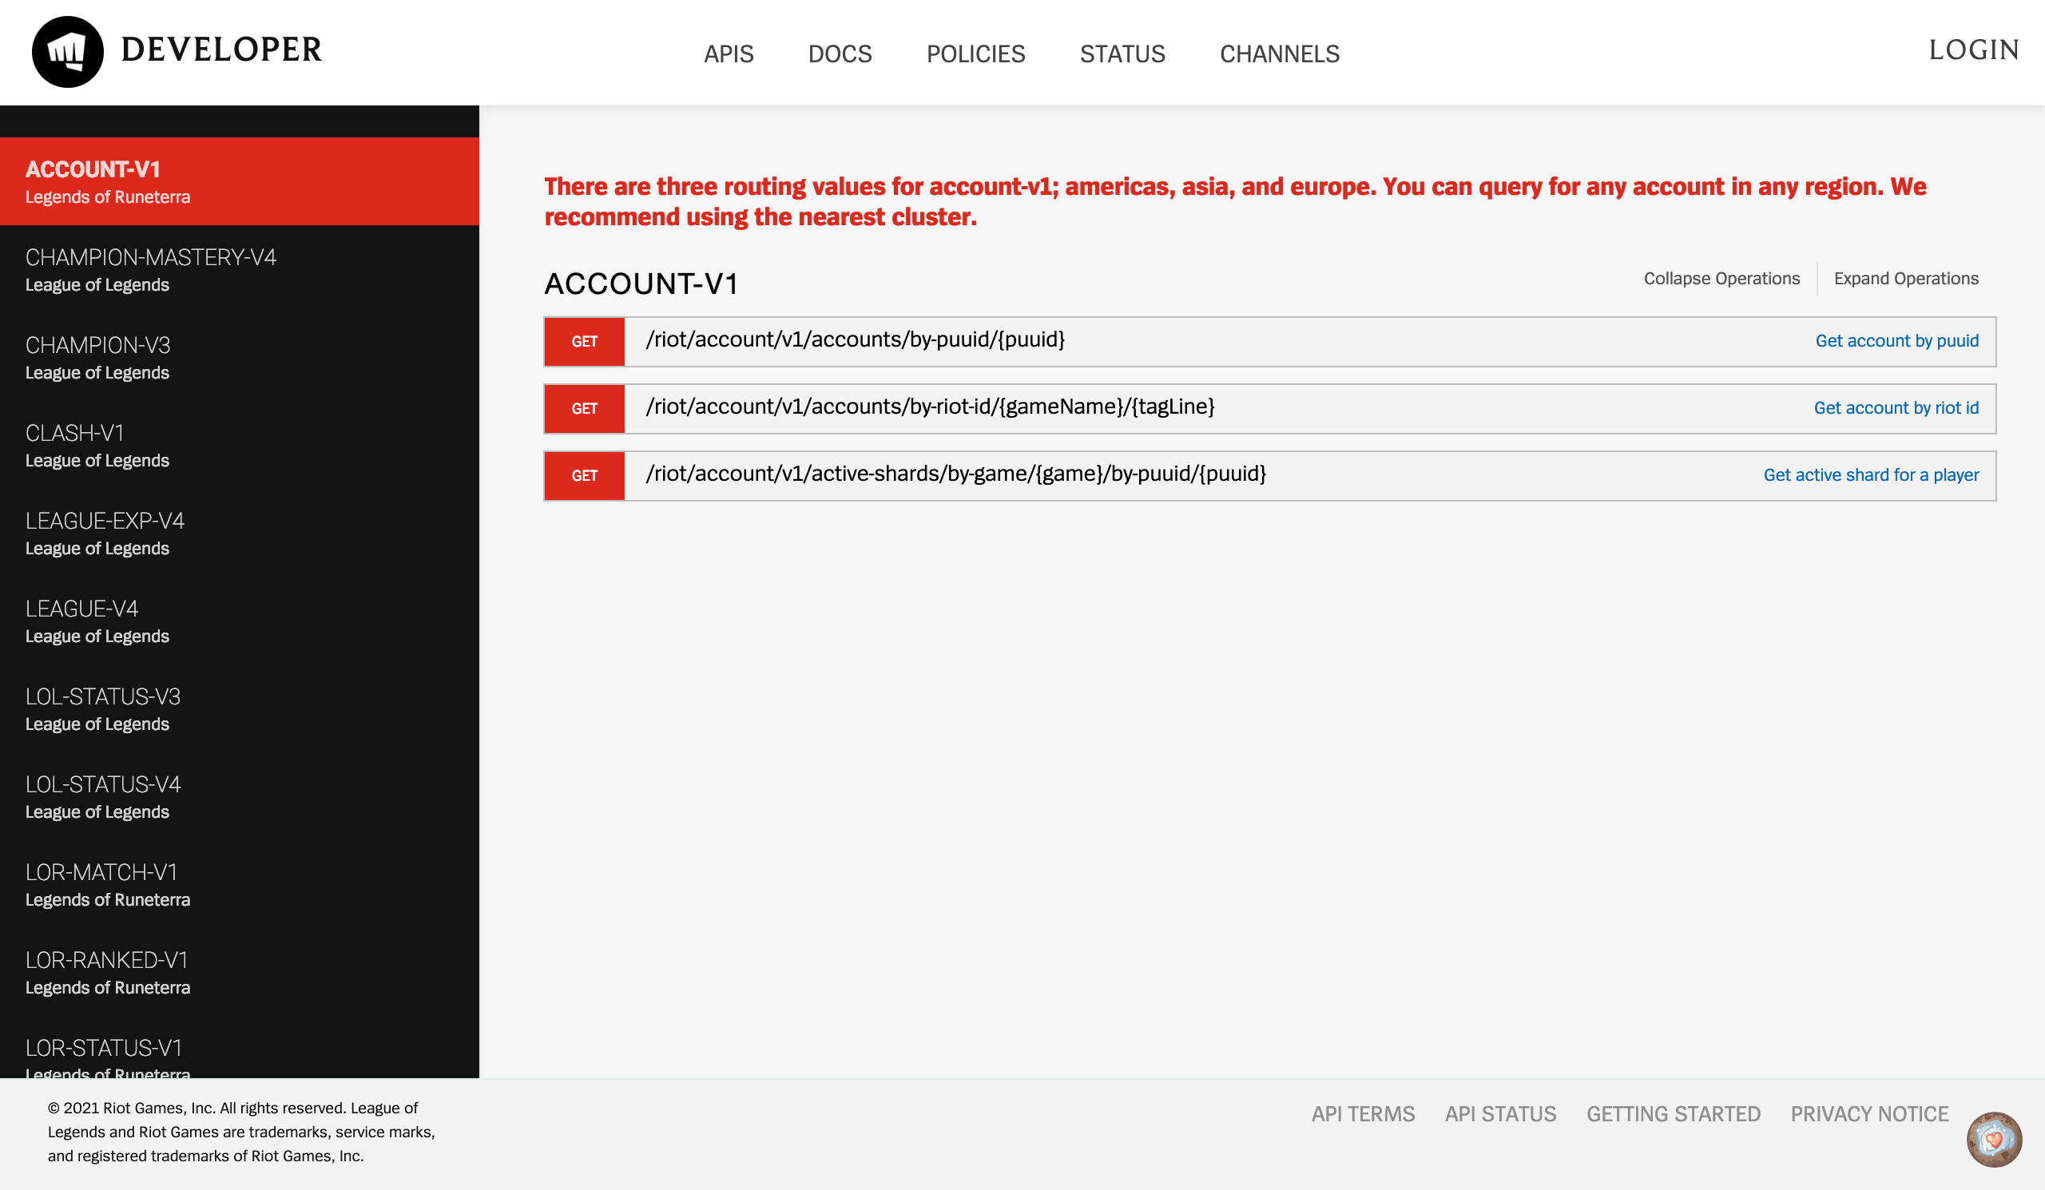
Getting data: Riot Games API
For getting the data I created a python script that called Riot APIs.
Firstly I got the account of the best 300 players in EUW server, then I got their last 20 games.
In the end I filtered the data to create a csv with the nodes (names, Ids and Roles) and one with the edges (from Ids, to Ids, weight)

Slide 4
Centrality studies
TOP | JUNGLE | MIDLANE | BOTTOM | SUPPORT
310 | 2486 | 2436 | 176 | 4615
I decided to use only the degree centrality because I needed to analyze the number of interactions.
The results weren’t something that I expect.
Then I calculated the degree between every couple of Roles. In this case the results surprised me even more.
 | TOP | JUNGLE | MIDLANE | BOTTOM | SUPPORT
TOP | X | 33.40 | 28.41 | 25.18 | 27.60
JUNGLE | 33.40 | X | 27.34 | 24.04 | 21.91
MIDLANE | 28.41 | 27.34 | X | 20.46 | 18.62
BOTTOM | 25.18 | 24.04 | 20.46 | X | 16.60
SUPPORT | 27.60 | 21.91 | 18.62 | 16.60 | X

Slide 5
Clustering analysis
2793 nodes
I tried to divide the graph in clusters to see if Roles and Clusters would have divided the nodes in the same way.
Even if I tried different types of similarity, the number of nodes in clusters weren’t omogenous.
38 nodes
32 nodes
46 nodes
26 nodes
«Non tutti i dati vogliono essere clusterizzati», ChatGPT

Slide 6
Thanks for your attention

